Slide 1
Exercise session 4
Week 5

Slide 2
Exercise 1 — Cadmium metabolism in an agricultural enterprise
An agricultural enterprise involves the processes of cultivation, which includes the vegetation itself, livestock production, and soil. To feed the livestock, the farmer uses both imported and internal fodder (1 and 15 gCd/y respectively). The products from the livestock (milk and meat) have a cadmium content of 2 gCd/y and are sold on the local market. The manure is used to fertilise the crops. The cadmium fallout from the atmosphere to the crops represents 30 gCd/y. The farmer also uses artificial fertiliser with a cadmium content of 5 gCd/y for the cultivation. We assume that all these cadmium inputs are assimilated by the vegetal cover and the concentration in the harvest is 17 gCd/y. Part of it is sold to the local market (2 gCd/y) and the rest is used as fodder. All the crop by–products decompose on the land to feed the soil. There is some erosion and run–off happening, which takes out 2 gCd/y from the soil into the water.
* within / beyond system boundaries (agricultural enterprise)
Draw the system as a quantitative flow chart and calculate the missing flows, as well as the stocks in the system.

Slide 3
Exercise 1 — Cadmium metabolism in an agricultural enterprise
An agricultural enterprise involves the processes of cultivation, which includes the vegetation itself, livestock production, and soil. To feed the livestock, the farmer uses both imported and internal fodder (1 and 15 gCd/y respectively). The products from the livestock (milk and meat) have a cadmium content of 2 gCd/y and are sold on the local market. The manure is used to fertilise the crops. The cadmium fallout from the atmosphere to the crops represents 30 gCd/y. The farmer also uses artificial fertiliser with a cadmium content of 5 gCd/y for the cultivation. We assume that all these cadmium inputs are assimilated by the vegetal cover and the concentration in the harvest is 17 gCd/y. Part of it is sold to the local market (2 gCd/y) and the rest is used as fodder. All the crop by–products decompose on the land to feed the soil. There is some erosion and run–off happening, which takes out 2 gCd/y from the soil into the water.
* within / beyond system boundaries (agricultural enterprise)
Cultivation
Soil
Livestock production
Agricultural enterprise

Slide 4
Exercise 1 — Cadmium metabolism in an agricultural enterprise
An agricultural enterprise involves the processes of cultivation, which includes the vegetation itself, livestock production, and soil. To feed the livestock, the farmer uses both imported and internal fodder (1 and 15 gCd/y respectively). The products from the livestock (milk and meat) have a cadmium content of 2 gCd/y and are sold on the local market. The manure is used to fertilise the crops. The cadmium fallout from the atmosphere to the crops represents 30 gCd/y. The farmer also uses artificial fertiliser with a cadmium content of 5 gCd/y for the cultivation. We assume that all these cadmium inputs are assimilated by the vegetal cover and the concentration in the harvest is 17 gCd/y. Part of it is sold to the local market (2 gCd/y) and the rest is used as fodder. All the crop by–products decompose on the land to feed the soil. There is some erosion and run–off happening, which takes out 2 gCd/y from the soil into the water.
* within / beyond system boundaries (agricultural enterprise)
Cultivation
Soil
15
Imports
Livestock production
1
Agricultural enterprise
Unit: [gCd/y]

Slide 5
Exercise 1 — Cadmium metabolism in an agricultural enterprise
An agricultural enterprise involves the processes of cultivation, which includes the vegetation itself, livestock production, and soil. To feed the livestock, the farmer uses both imported and internal fodder (1 and 15 gCd/y respectively). The products from the livestock (milk and meat) have a cadmium content of 2 gCd/y and are sold on the local market. The manure is used to fertilise the crops. The cadmium fallout from the atmosphere to the crops represents 30 gCd/y. The farmer also uses artificial fertiliser with a cadmium content of 5 gCd/y for the cultivation. We assume that all these cadmium inputs are assimilated by the vegetal cover and the concentration in the harvest is 17 gCd/y. Part of it is sold to the local market (2 gCd/y) and the rest is used as fodder. All the crop by–products decompose on the land to feed the soil. There is some erosion and run–off happening, which takes out 2 gCd/y from the soil into the water.
* within / beyond system boundaries (agricultural enterprise)
Atmosphere
30
Cultivation
Soil
?
15
Imports
Livestock production
Local market
1
2
Agricultural enterprise
Unit: [gCd/y]

Slide 6
Exercise 1 — Cadmium metabolism in an agricultural enterprise
An agricultural enterprise involves the processes of cultivation, which includes the vegetation itself, livestock production, and soil. To feed the livestock, the farmer uses both imported and internal fodder (1 and 15 gCd/y respectively). The products from the livestock (milk and meat) have a cadmium content of 2 gCd/y and are sold on the local market. The manure is used to fertilise the crops. The cadmium fallout from the atmosphere to the crops represents 30 gCd/y. The farmer also uses artificial fertiliser with a cadmium content of 5 gCd/y for the cultivation. We assume that all these cadmium inputs are assimilated by the vegetal cover and the concentration in the harvest is 17 gCd/y. Part of it is sold to the local market (2 gCd/y) and the rest is used as fodder. All the crop by–products decompose on the land to feed the soil. There is some erosion and run–off happening, which takes out 2 gCd/y from the soil into the water.
* within / beyond system boundaries (agricultural enterprise)
Atmosphere
30
Cultivation
Soil
5
?
15
2
Imports
Livestock production
Local market
1
2
Agricultural enterprise
Unit: [gCd/y]

Slide 7
Exercise 1 — Cadmium metabolism in an agricultural enterprise
An agricultural enterprise involves the processes of cultivation, which includes the vegetation itself, livestock production, and soil. To feed the livestock, the farmer uses both imported and internal fodder (1 and 15 gCd/y respectively). The products from the livestock (milk and meat) have a cadmium content of 2 gCd/y and are sold on the local market. The manure is used to fertilise the crops. The cadmium fallout from the atmosphere to the crops represents 30 gCd/y. The farmer also uses artificial fertiliser with a cadmium content of 5 gCd/y for the cultivation. We assume that all these cadmium inputs are assimilated by the vegetal cover and the concentration in the harvest is 17 gCd/y. Part of it is sold to the local market (2 gCd/y) and the rest is used as fodder. All the crop by–products decompose on the land to feed the soil. There is some erosion and run–off happening, which takes out 2 gCd/y from the soil into the water.
* within / beyond system boundaries (agricultural enterprise)
Atmosphere
30
Cultivation
?
Soil
2
Hydrosphere
5
?
15
2
Imports
Livestock production
Local market
1
2
Agricultural enterprise
Unit: [gCd/y]

Slide 8
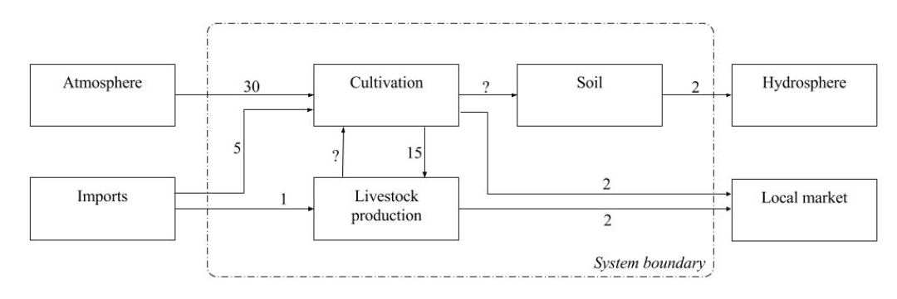
Exercise 1 — Cadmium metabolism in an agricultural enterprise
Draw the system as a quantitative flow chart and calculate the missing flows, as well as the stocks in the system.
Calculate the transfer coefficient of the run–off to water for the entire system.

Slide 9
Exercise 1 — Cadmium metabolism in an agricultural enterprise
Draw the system as a quantitative flow chart and calculate the missing flows, as well as the stocks in the system.
Flow (livestock–cultivation, i.e. manure):
Total input = 1 + 15 = 16
Known output from livestock production = 2
Assuming steady state, manure = 16 - 2 = 14

Slide 10
Exercise 1 — Cadmium metabolism in an agricultural enterprise
Draw the system as a quantitative flow chart and calculate the missing flows, as well as the stocks in the system.
Flow (livestock–cultivation, i.e. manure):
Total input = 1 + 15 = 16
Known output from livestock production = 2
Assuming steady state, manure = 16 - 2 = 14
Flow (cultivation–soil, i.e. decomposition):
Total input = 30 + 5 + 14 = 49
Known outputs from cultivation = 15 + 2 = 17
Assuming steady state, decomposition = 49 - 17 = 32

Slide 11
Exercise 1 — Cadmium metabolism in an agricultural enterprise
Draw the system as a quantitative flow chart and calculate the missing flows, as well as the stocks in the system.
Flow (livestock–cultivation, i.e. manure):
Total input = 1 + 15 = 16
Known output from livestock production = 2
Assuming steady state, manure = 16 - 2 = 14
Flow (cultivation–soil, i.e. decomposition):
Total input = 30 + 5 + 14 = 49
Known outputs from cultivation = 15 + 2 = 17
Assuming steady state, decomposition = 49 - 17 = 32
Stock in soil:
dStock/dt = 32 - 2 = 30

Slide 12
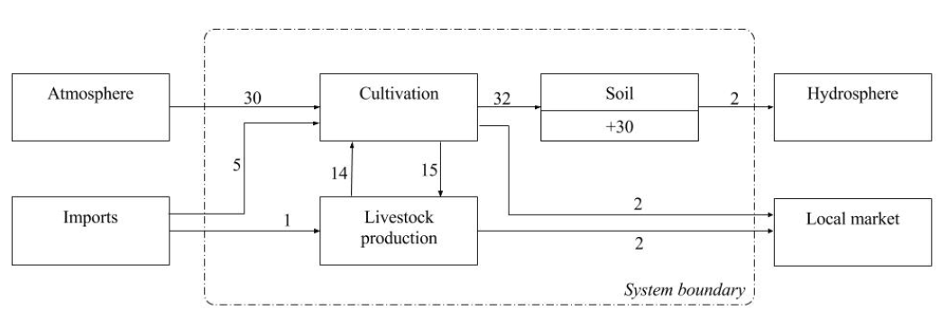

Exercise 1 — Cadmium metabolism in an agricultural enterprise
Draw the system as a quantitative flow chart and calculate the missing flows, as well as the stocks in the system.
Calculate the transfer coefficient of the runoff to water for the entire system.

